Slide 1
Category review: Chips
Jan 2024
Retail Analytics
Brand note: If client logo is not required, use alternate title page layout right click slide thumbnail > Layout > Title

Slide 2
Notes:
To view Privacy video explaining how important data privacy is to Quantium, please click here: https://www.youtube.com/watch?v=Zq1QDAkoRzU
or here Q:\Company Reference\Brand & Design\Brand videos\Q Privacy.mp4
At Quantium, we believe that data is the behavioural footprint of humanity and that it has to be treated with the utmost care and responsibility.
Histories, attitudes, indeed lives are stored within it in ways that aren’t always apparent – and that’s what makes its potential so powerful.
To work with it responsibly, sensitively, we set ourselves the highest data privacy protection and governance standards.
We have spent 17 years perfecting privacy-by-design and secure-by-design principles. Central to this is not holding any personally identifiable information about people –
we neither receive it, and put the necessary protections in place to be unable to decipher it.
Every aspect of handling data is safeguarded: from its de-identification, to its encryption – data security is paramount and of the highest grade.
We pride ourselves on gaining the trust of iconic organisations around the world through years of securely working with their data,
and in turn the trust that builds with their stakeholders.

Slide 3
Executive summary
01
Customer Analytics
The three highest contributing segments to total sales are Mainstream Mid-age Singles/Couples, Premium Retirees and Budget Older Singles/Couples .
Factor driving sales are older families have largest total number of chips packets purchased.
The top product that was purchased was Kettle Mozzarella Basil and Pesto 175 g having a count of 3304.
02
Trail Store Analysis
(Uplift Analysis)
A trial changing the store layout was implemented in three stores.
A control store was constructed to reflect the prior performance of the selected trial store.
The trial saw a significant increase in the total sales and number of customers with a new store layout.

Slide 4
01
Customer Analytics

Slide 5
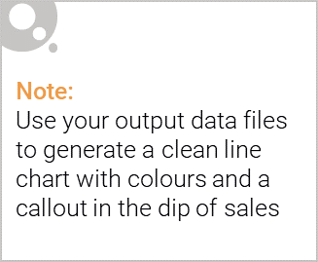
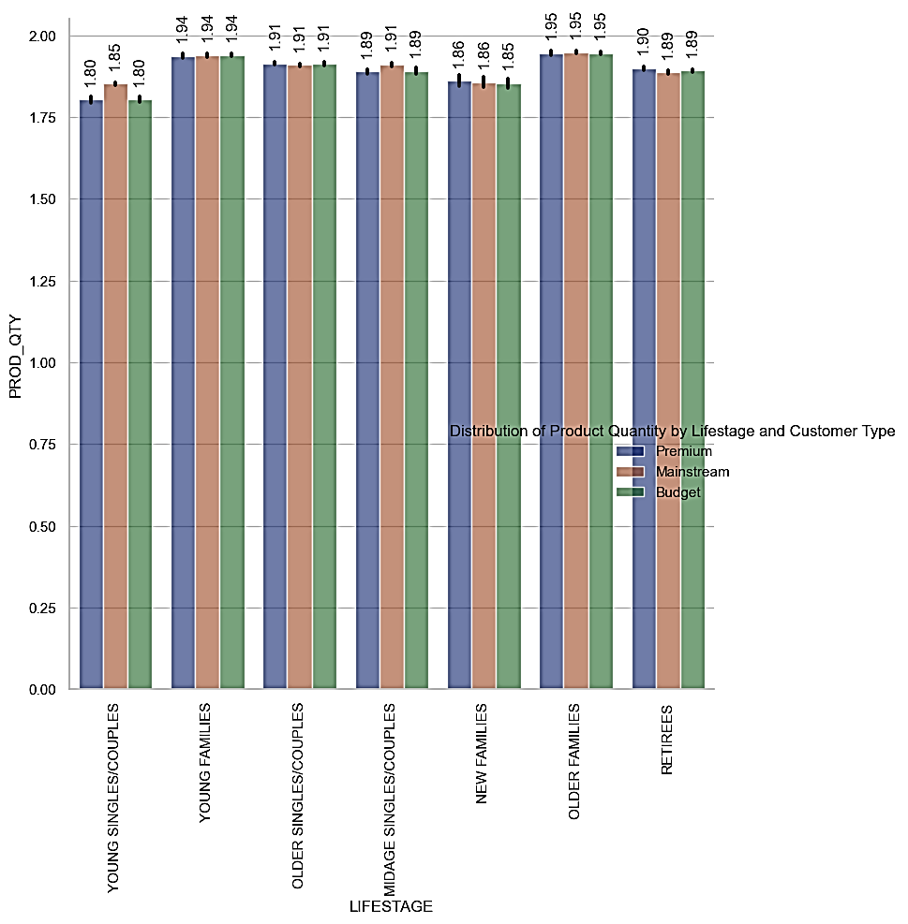
Older and Younger Families group purchased more number of chips packets.

Slide 6
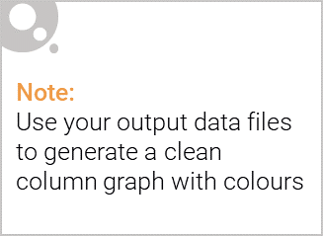
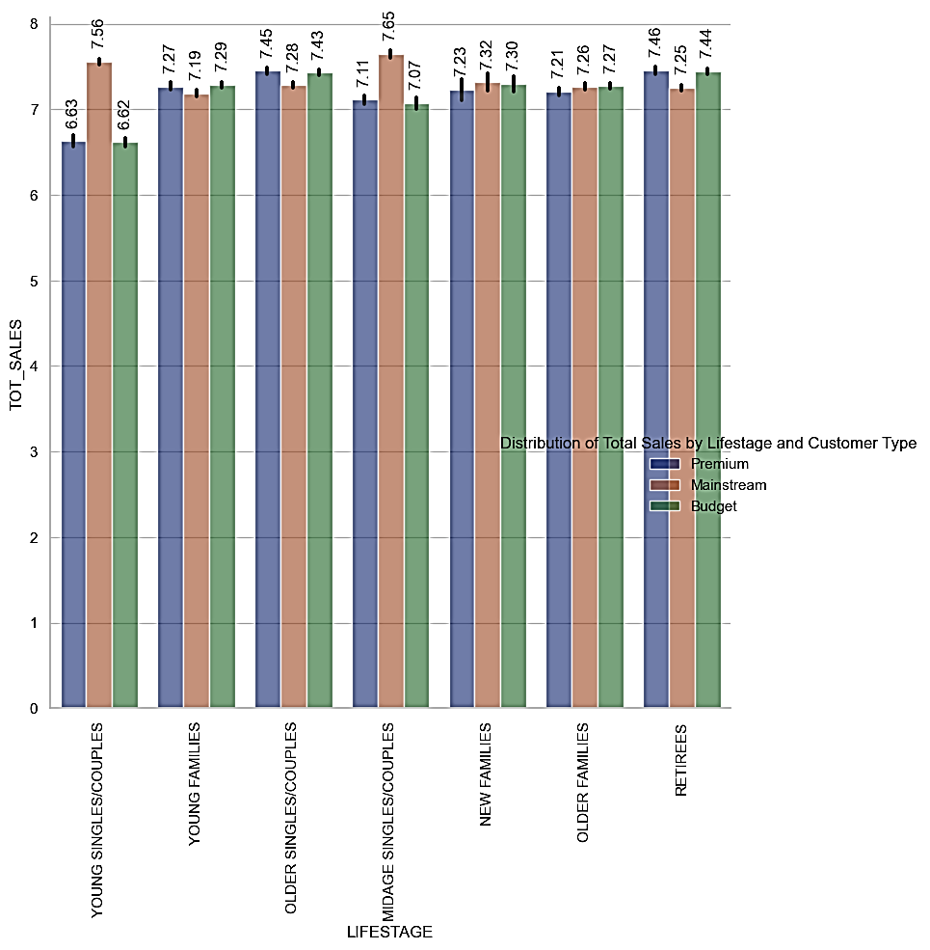
Instead, Sales are coming from Mainstream Mid-Age Singles/Couples followed by Premium Retirees.

Slide 7
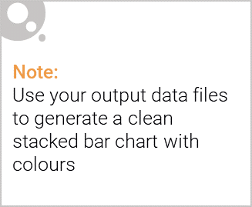
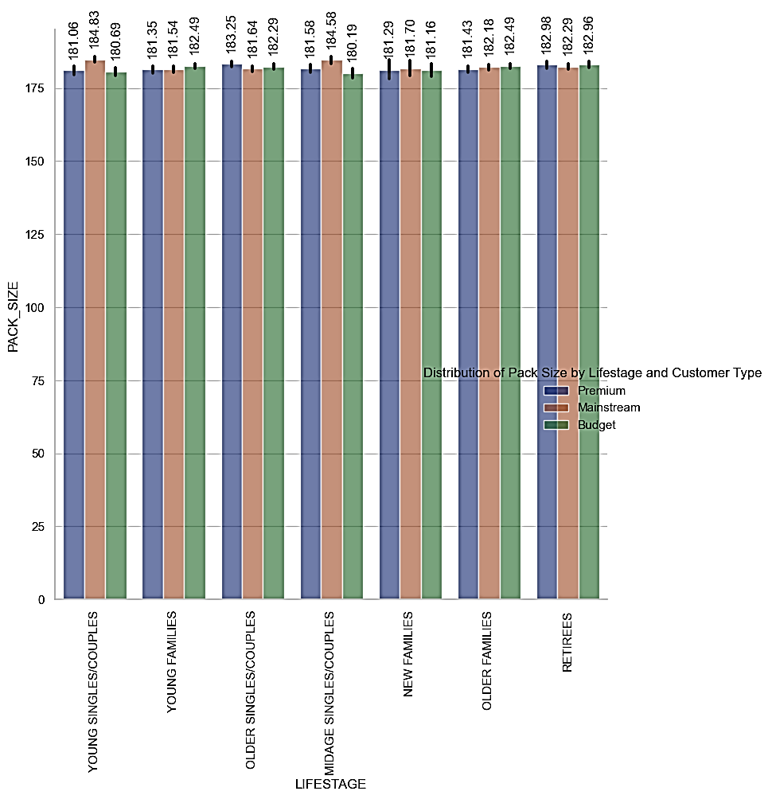
Editable (delete this)
Mainstream Young Singles/Couples have the highest consumption of chips by packet size leading to an increase in the total sales.

Slide 8
02
Trial store performance

Slide 9
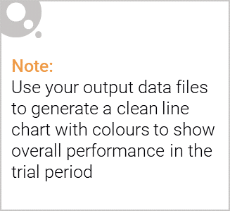
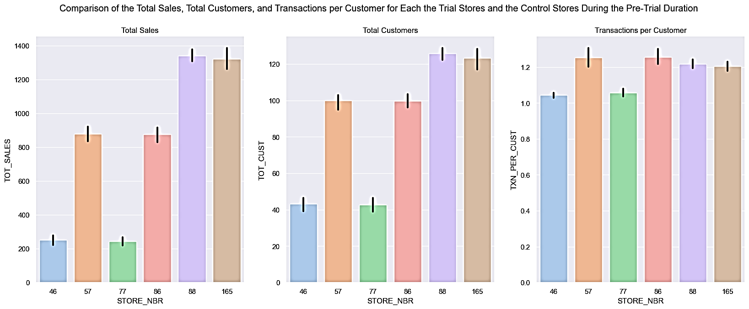
While the other trial stores performed the same as their corresponding control stores, we can see, however, that STORE_NBR 88 slightly out-performed its control store in all attributes. We can also notice that STORE_NBR 86 and 88 show a significant difference in terms of the total sales, but this isn't the case with STORE_NBR 77, whose sales are considerably less.

Slide 10
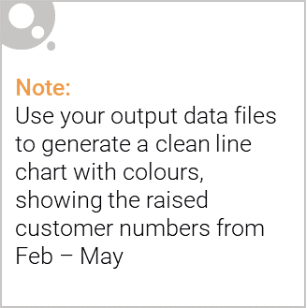
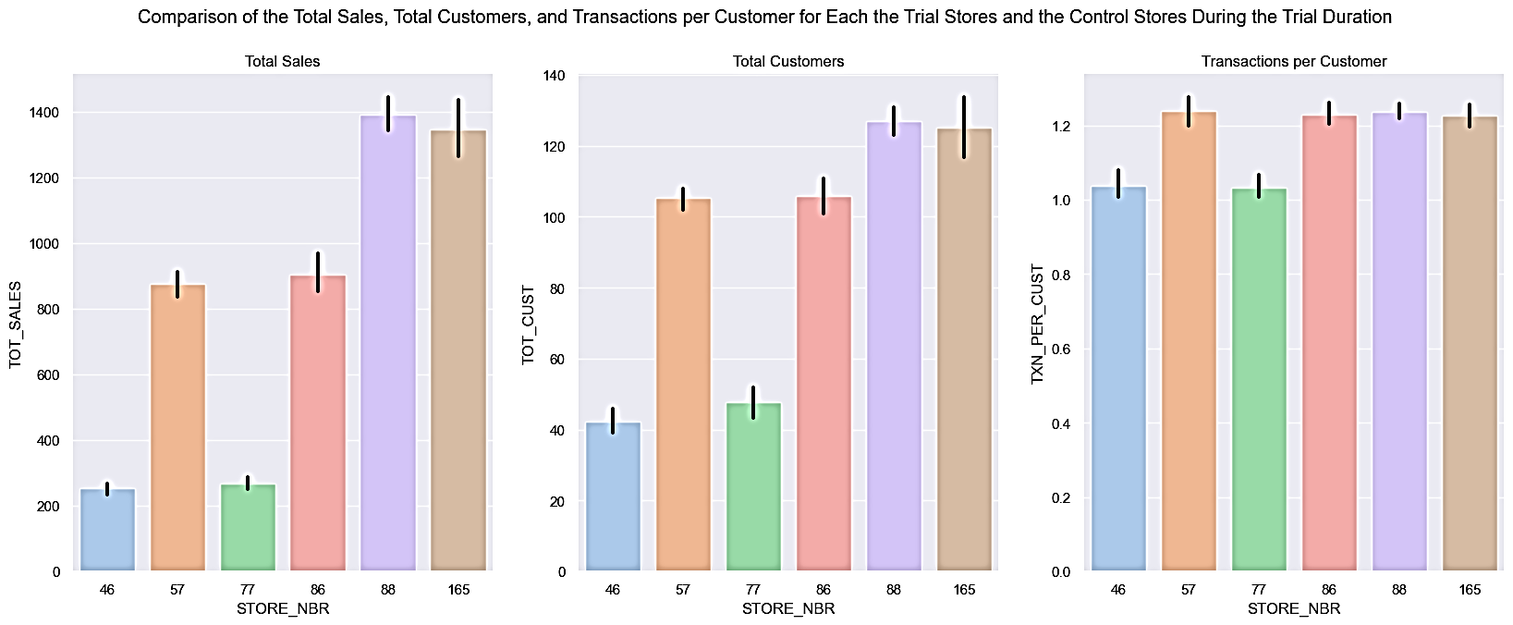
We can, notice that STORE_NBR 88 slightly out-performs its control store, STORE_NBR 165, and still remains the best implementation of the trial of all the trial stores. The driver for this seems to be the purchasing customers rather than purchases per customer, as we can see that with the increase in the total customers, there's also an increase in the total sales almost identically, but the transactions per customer seem to be reasonably high for all the trial stores regardless of the total sales.

Slide 11
Conclusion
While the other trial stores performed the same as their corresponding control stores, we can see, however, that STORE_NBR 88 slightly out-performed its control store, STORE_NBR 165, in all attributes.
STORE_NBR 86 and 88 show a significant difference in terms of the total sales, but this isn't the case with STORE_NBR 77, which may be because of the way the trial was implemented for it.
Due to the maximum difference in the total sales of all the trial stores, STORE_NBR 88 remains the best implementation of the trial.
--> The driver for the increase in total sales seems to be the purchasing customers rather than purchases per customer — the more the customers, the higher the sales.

